Slide 1
Project Vulpix
Week 5 Report

Slide 2

Game Board
Opponent’s hand
Opponent’s Bench
Opponent’s Active
Opponent’s Discard
Opponent’s prize
Opponent’s Deck
Stadium
Player’s Deck
Player’s Prizes
Player’s Bench
Player’s Discard
Player’s Hand
Player’s Active

Slide 3

Turns
Draw a card
Play Trainers
Play Pokemon
Play Energy
Use Abilities
Retreat
Attack

Slide 4


Attacking
Name
Energy Cost
Shows the type and amount of energy needed to attack
Name of the attack
Effect
Special things that happen when an attack is used
Damage
Amount of damage done to the opposing active pokemon
Energy Cost
Effect
Damage

Slide 5
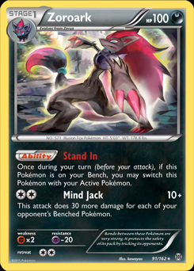
Attacking Code

Slide 6
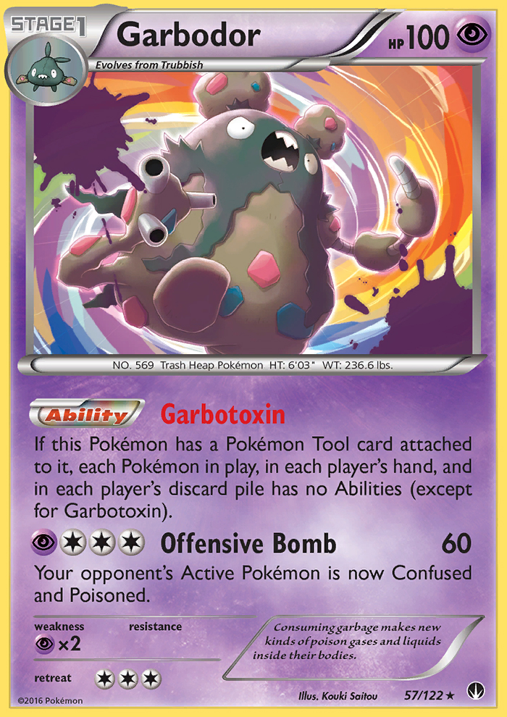
Abilities
Special actions that can be done during a turn
Can be passive or active
Don’t count as attacks

Slide 7
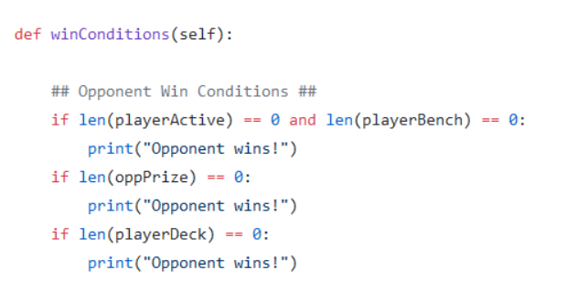
Win Conditions
Deck Out
Prize Out
No Active

Slide 8
Deck Out
At the start of a turn the player must draw a card. If their deck is empty at this time they lose.

Slide 9
Prizes Out
Prizes are taken with knockouts
When a player has taken all prize cards, they win

Slide 10
No Pokemon in play
A player has no Active Pokemon and no Bench Pokemon to use they lose

Slide 11
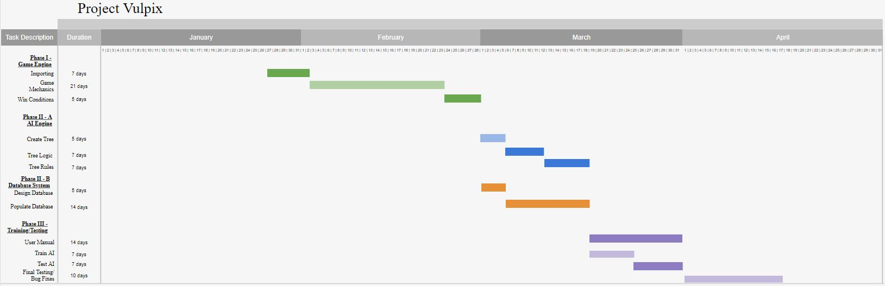
ON Time

Slide 12
Next Week
Start AI this week. YAY!
Design the AI
Change game engine to work with AI design

